Slide 1
Invoice Template Generator
jBilling Academy

Slide 2
Agenda
jB Academy – Invoice Template Generator
Why do we need this?
History
The invoice template generator
Test

Slide 3
Agenda
jB Academy – Invoice Template Generator
Why do we need this?
History
The invoice template generator
Test

Slide 4
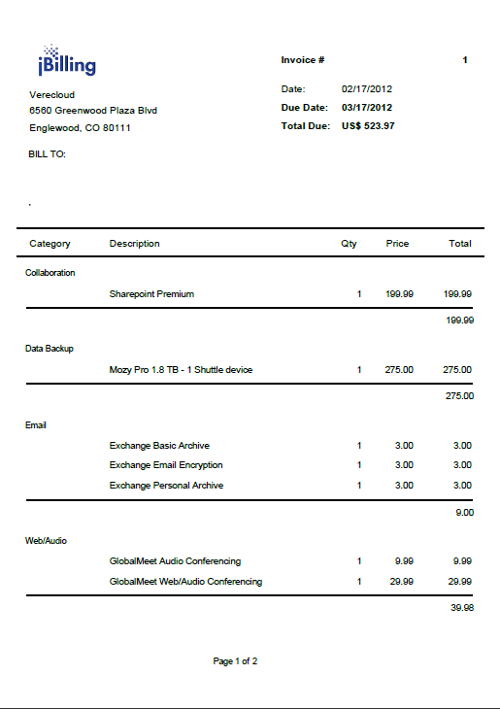
What is an invoice design?
Design File
Blue_Style.jasper
JasperReports
Data
Invoice, customer, payments info

Slide 5
Why would you need to create an invoice?
Every company has its own idea of what an ‘nice, useful’ invoice is. They requests us to create an invoice with a particular layout, logic and data in it. This varies between customers.
An invoice is an important ‘report’ that a company sends to its customers. If the company wants to get paid, it needs a clear and comprehensive invoice. Otherwise, its customers might dispute the amounts or simply not know how much they need to pay.

Slide 6
Agenda
jB Academy – Invoice Template Generator
Why do we need this?
History
The invoice template generator
Test

Slide 7
History
JasperReports was and is the way to generate a PDF invoice
Design File
Blue_Style.jasper
JasperReports
Data
Invoice, customer, payments info

Slide 8
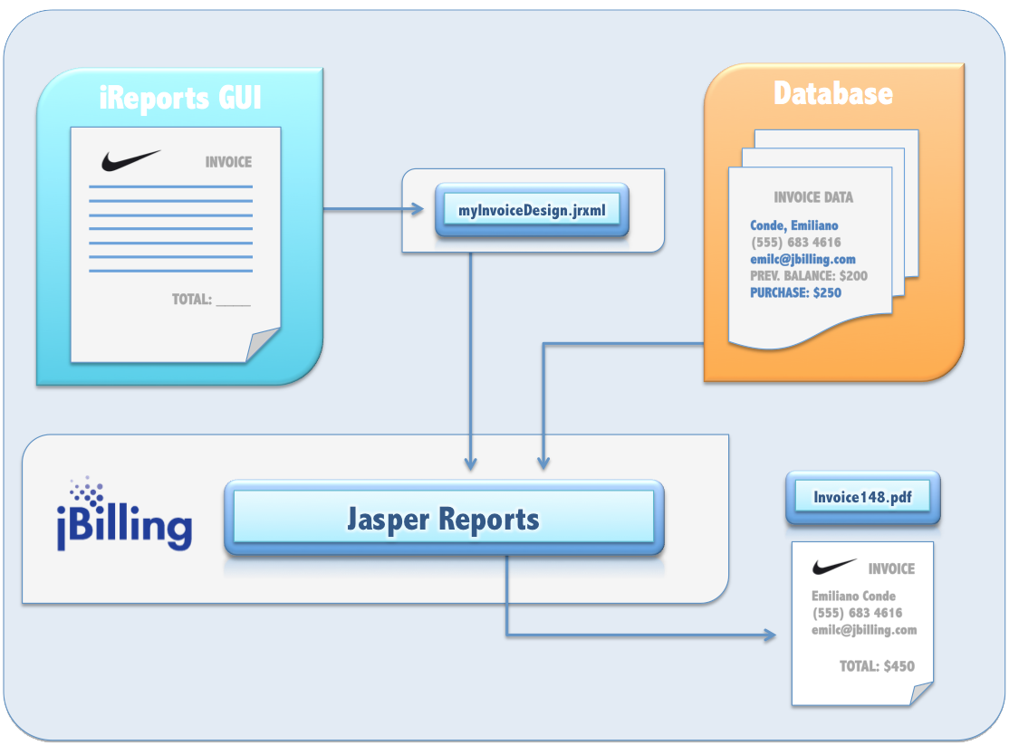
History
How do we generate the Design File? IReports

Slide 9
History
How do we generate the Design File? IReports
Pros
Unlimited flexibility
Any design or data is possible with enough work
Cons
Only a Java developer can do this
It is hard to test: a change in the design needs to be compiled and deployed in an installation with invoices for testing
Lots of room for errors
Takes weeks of work to produce a medium complexity invoice

Slide 10
Transition
Starting on jBilling 4, there are two options
Invoice Template Generator
Allows for much faster development
Has limitations on what can be shown and how
Pure JasperReports
Unlimited flexibility
Any design or data is possible with enough work
Takes weeks of work to produce a medium complexity invoice
Expensive

Slide 11
Invoice Template Generator
Overview
ITG
Design File
Blue_Style.jasper
JasperReports
Data
Invoice, customer, payments info

Slide 12
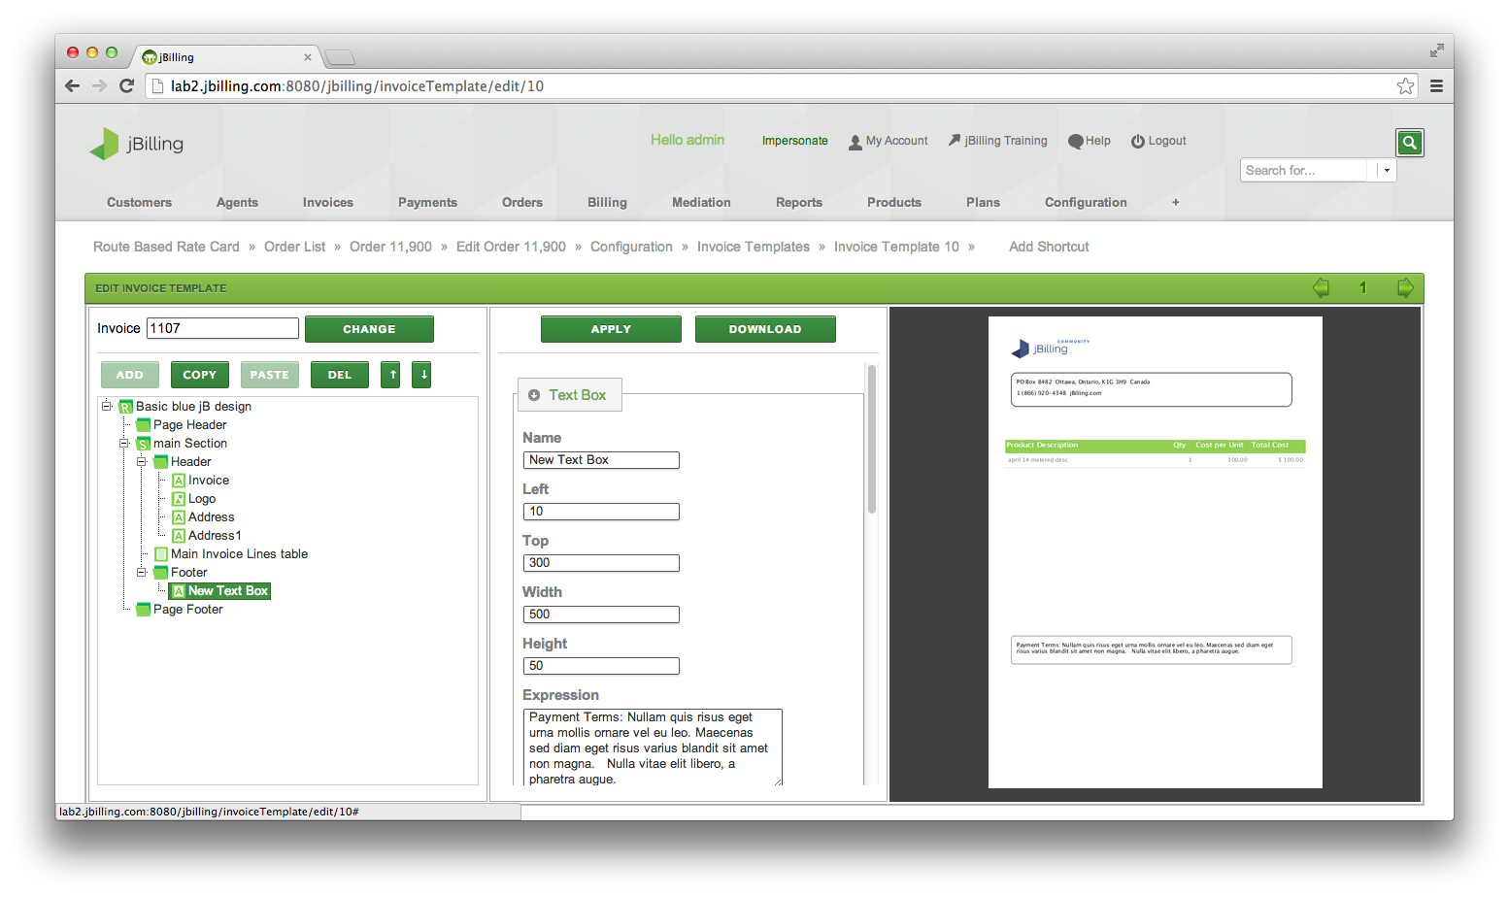
Invoice Template Generator
It is a tool embedded in the jBilling UI
No need to learn another UI such as iReports
It allows immediate preview, selecting an actual invoice
It is not a generic reporting tool, it knows about invoices sections and data
Overview

Slide 13
Invoice Template Generator
Components
Header
Once the structure is understood, the components are easy to use
Image
Header
Text Box
Section
Invoice Lines
Design
List
CDRs
Section
Footer
Footer

Slide 14
Invoice Template Generator
Expressions
Expressions help adding data from the data base into the invoice
For an expression to work, a String needs to be build
“Please have this number ready when calling our help desk “ + $P{invoice_id}
Note the quotes, and the + to create one string.
$P, $F: data from jBilling
$V: internal variable from Jasper

Slide 15
Invoice Template Generator
Extending
The most common need is more data: some variable to be available to JasperReports
To add a new variable, edit

Slide 16
Invoice Template Generator
Test
Create a simple invoice using the ITG
Start from scratch
Put invoice lines
Add some typical text
iReports
Install iReports
Edit the standard jrxml
Make a simple modification
Compile, deploy

